Slide 1
RECORDER, Status Update, 26th October 2020
Marine plankton response to the last deglaciation
- preliminary results -
Anne Strack
PhD student
Micropalaeontology/Paleoceanography
MARUM – Center for Marine Environmental Sciences
University Bremen
Office: MARUM II, R2050
Tel. +49 (0) 421 218 – 65956
astrack@marum.de

Slide 2
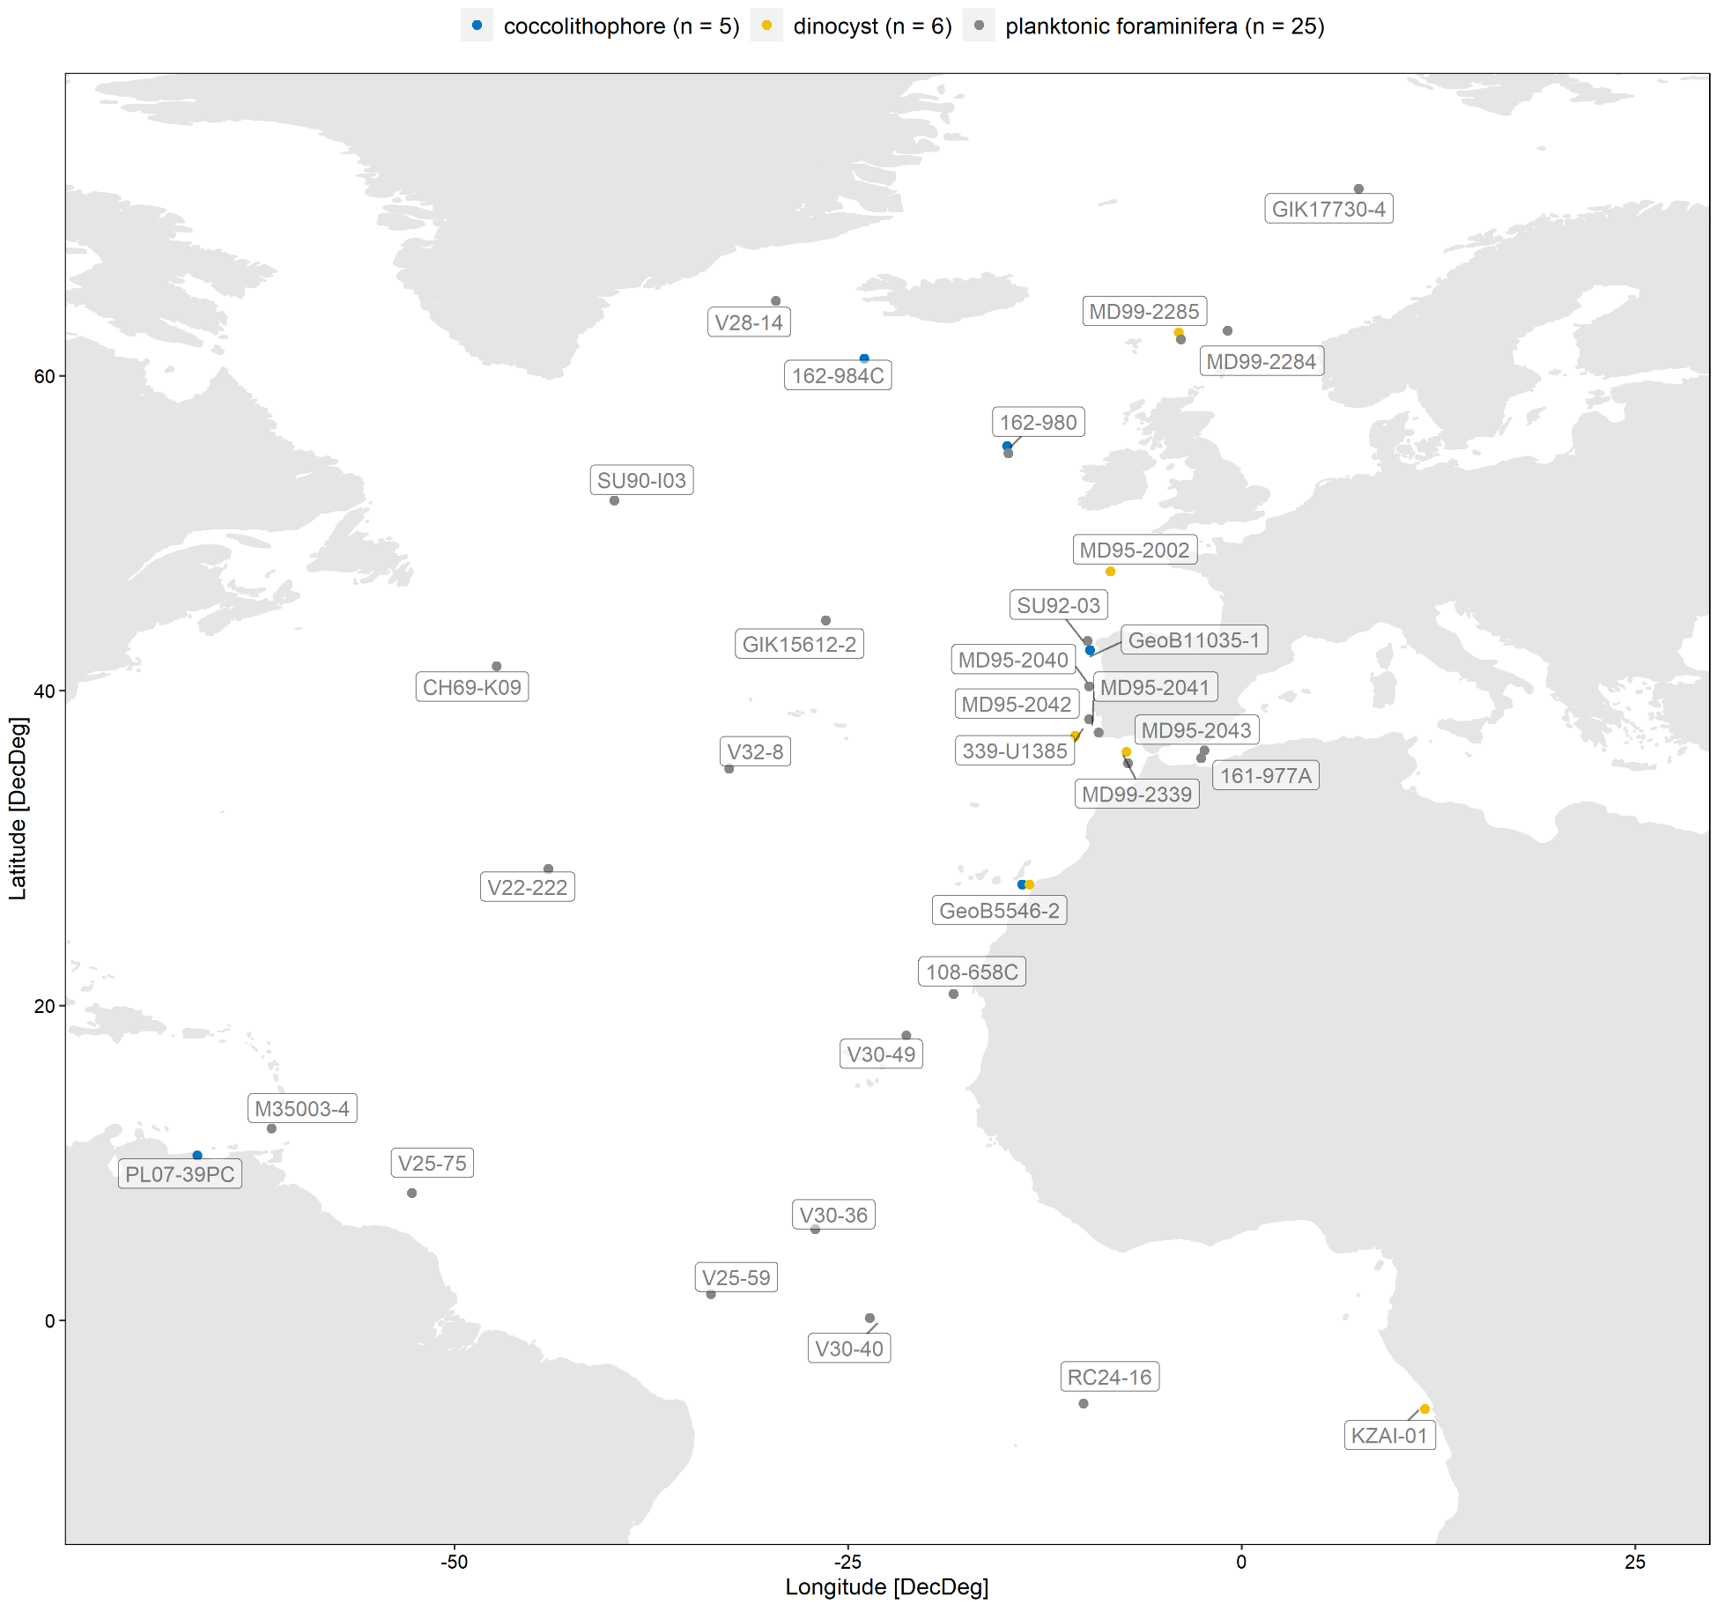
Map: Overview of core locations in North Atlantic Ocean data set
Total: 36 records
Planktonic foraminifera (25 records, grey dots)
Dinocysts (6 records, yellow dots)
Coccolithophores (5 records, blue dots)
Used as tropical
reference site

Slide 3
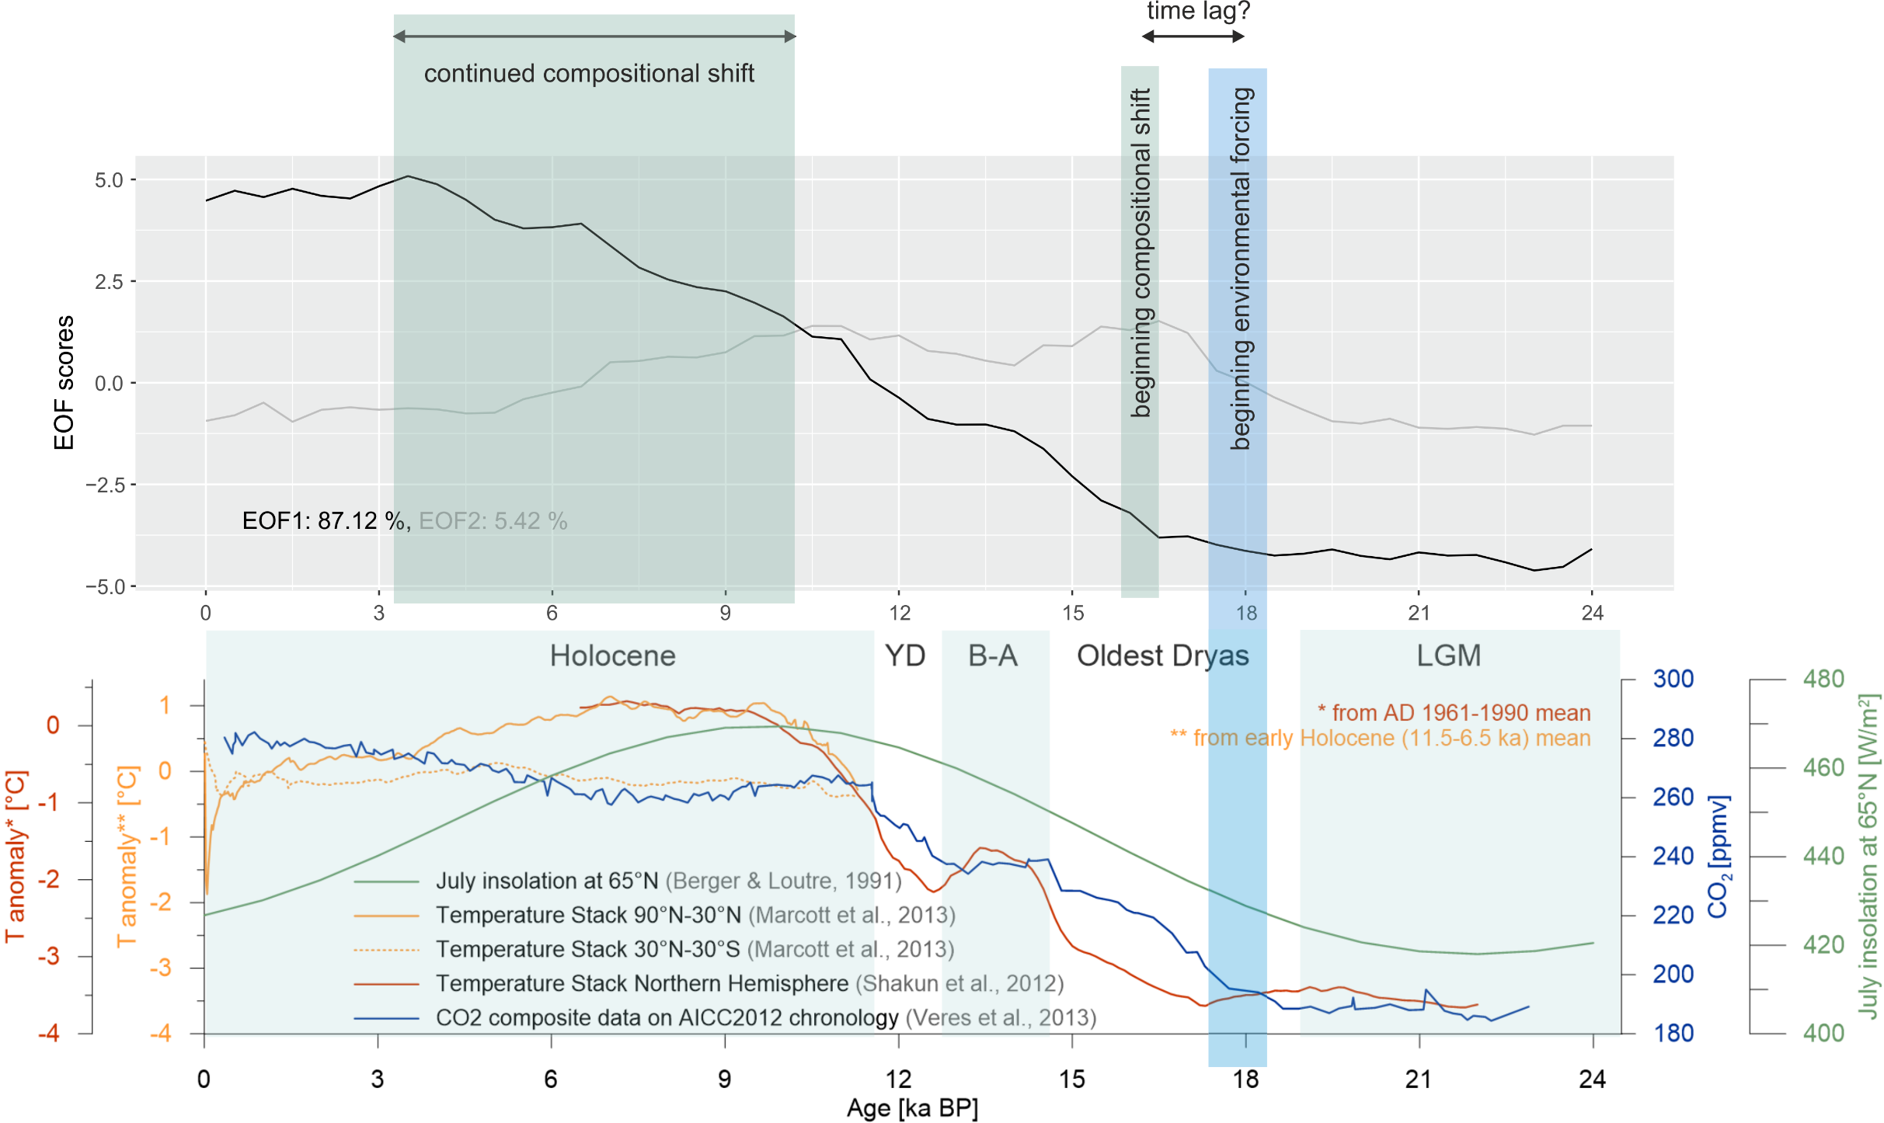
EOF vs. climate (preliminary)
Considerable part of the observed compositional change not forced by climate?
Notes:
We used the records of the planktonic foraminifera data set to first determine the shape of the major compositional change in each record by principle components analyses. The mean global response of the plankton to the deglaciation was then evaluated by an Empirical Orthogonal Function (EOF) analysis of the main biotic trends across all sites.
We find that the dominant response of the zooplankton consists of synchronous unidirectional shifts initiated between 16-17 ka BP, and progressing into the Holocene. When regressed on the global ocean temperature and CO2 trends, we can see a proportionate response to the forcing during the last glacial maximum, the deglaciation and the early Holocene. In contrast, the late Holocene is characterised by continued compositional change, which does not appear related to environmental forcing. We speculate that this decoupling indicates the existence of a multi-millennial delay in community change following the climatic forcing.

Slide 4
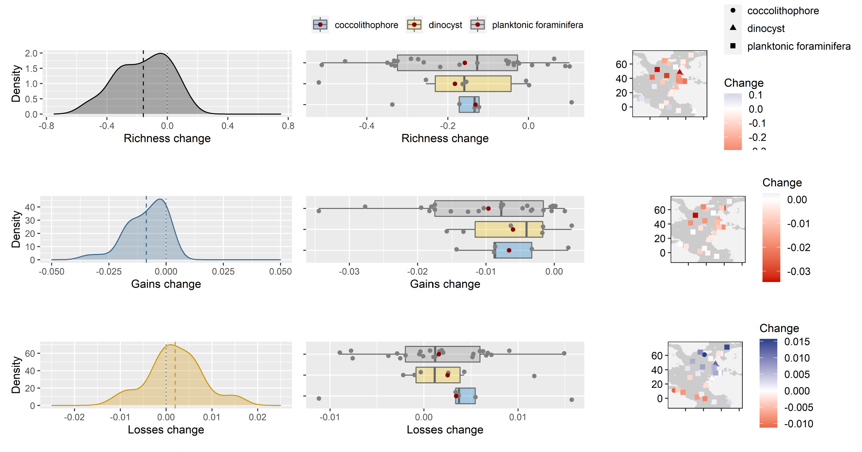
Overview of site-specific community metrics of North Atlantic Ocean data set
Notes:
We calculated changes in community metrics (richness, gains and losses) for each record of the North Atlantic Ocean data set for the last 24 ka. This overview plot shows consistent change in the flora/fauna such as increasing number of species at mid latitudes and decreasing number at low latitudes. Furthermore, the change in species gains is most prominent at mid latitudes whereas most species losses during the last deglaciation occur at low latitudes. This change could reflect species moving, but could also imply formation of new communities (i.e. with different composition than found anywhere).
Figure explanation:
The different rows of this plot correspond to changes in different community metrics (1. richness, 2. gains, 3. losses) calculated for each individual site. The first column shows the data as density plots and the second column shows the same data as box plots separated by the specific plankton groups. The third column shows the change of the specific community metric in a geographical context.
Methods:
Richness change: Species richness (# of species) for each sample at each site. The site-specific change is then calculated as the slope of the linear model.
Gains/losses change: Species gains and losses (in percent) as the proportion of species either gained or lost relative to the total number of species observed across both time periods (always compared to the oldest sample in the record). Note: the species gains/losses take actual species identity into account, it’s not only the change in # of species. The site-specific change is then again calculated as the slope of the linear model.
NOTE: A negative slope (red colour in geographical maps) in e.g. richness change means that the number of species increased from the LGM to recent times. It’s kind of counter-intuitive, but it’s because of the x-axis (time). However, for a better intelligibility, this can be easily changed.

Slide 5
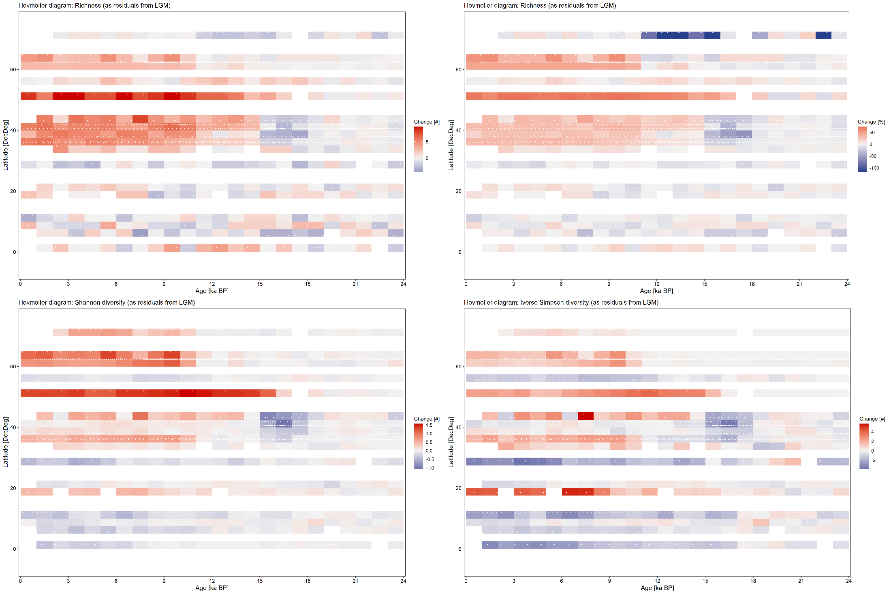
Gridded Hovmoller plots for richness [# and %], Shannon and Inverse Simpson diversity expressed as residuals from LGM mean
Top row: richness [x and %]
Bottom row: Shannon and Inverse Simpson diversity
Red colours: positive residuals
Blue colours: negative residuals
Tropical diversity dip not visible in species richness, but in abundance based diversity measures
Species richness is barely changing throughout the last 24 ka in the tropics, but the allocation patterns start to change from 18-15 ka
Most change at mid latitudes: big drop between 18-15 ka (Heinrich event?) followed by increase that surpasses the LGM state

Slide 6
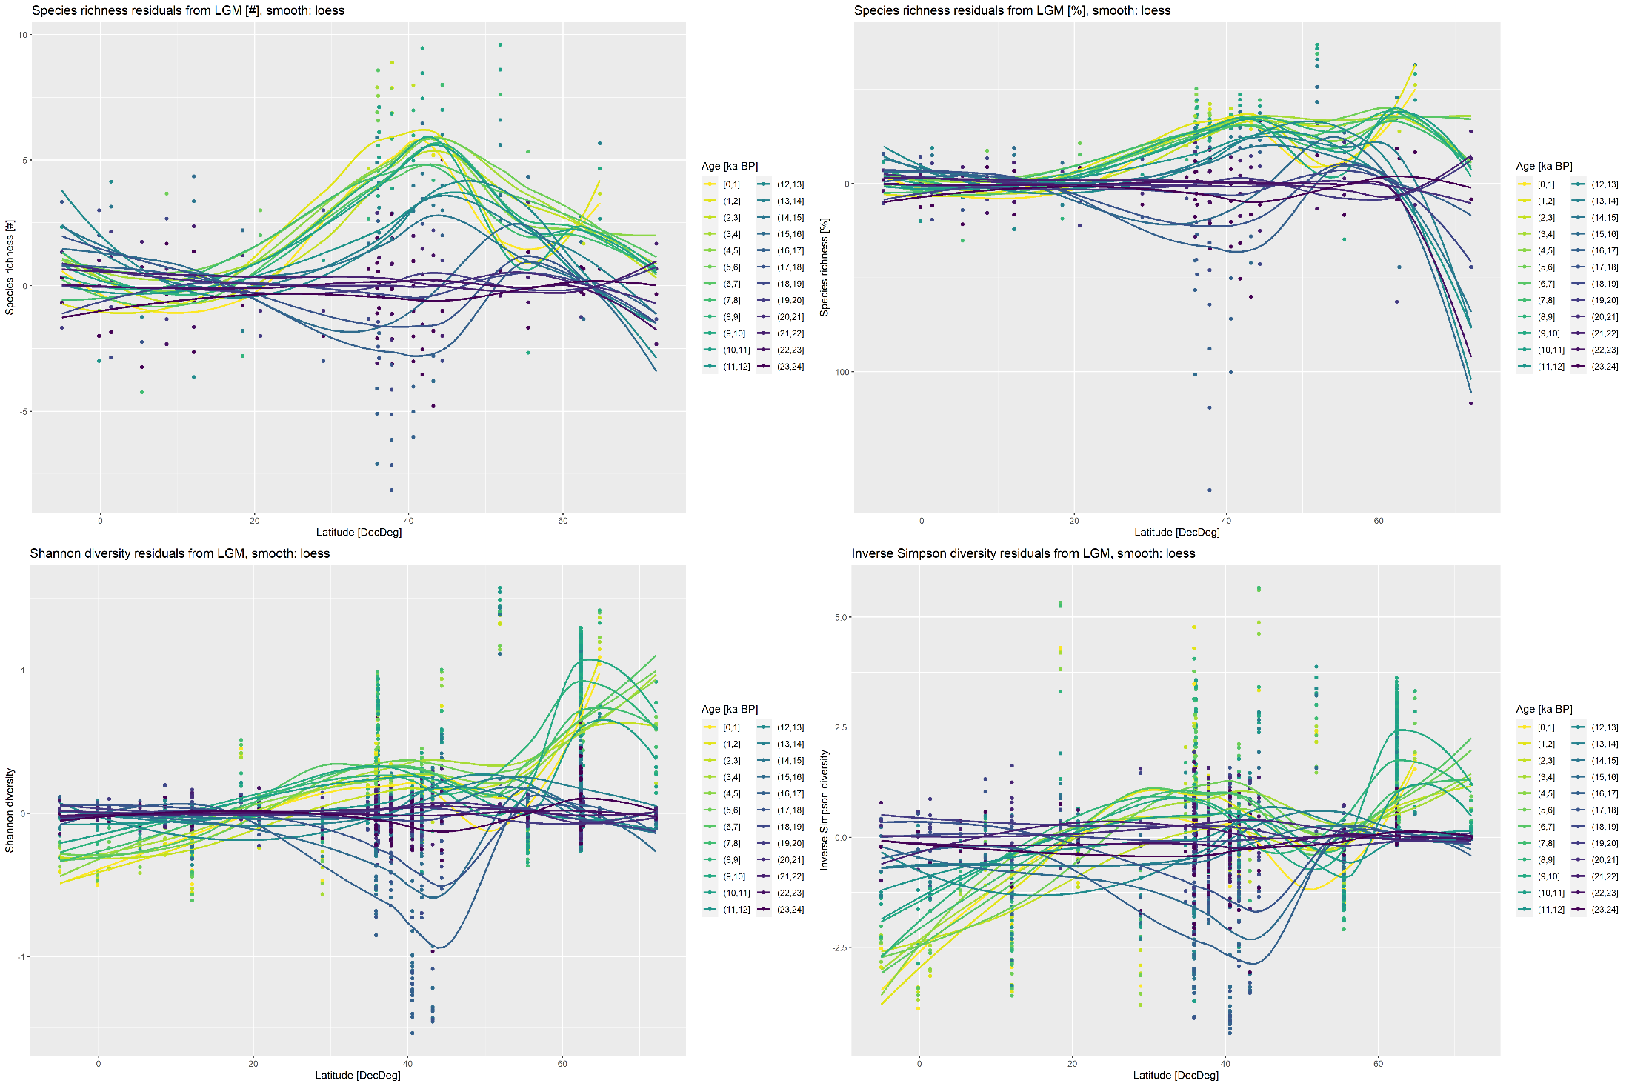
LDG plots (binned by age) for richness [# and %], Shannon and Inverse Simpson diversity expressed as residuals from LGM mean (loess smooth)
Top row: richness [x and %]
Bottom row: Shannon and Inverse Simpson diversity
Binned by age (yellow = recent, purple = LGM)
Again, tropical diversity dip not visible in species richness, but in abundance based diversity measures
Continuous turnover until well into the Holocene
→Progressive changes through time and space during the deglaciation and continuing into the Holocene?

Slide 7
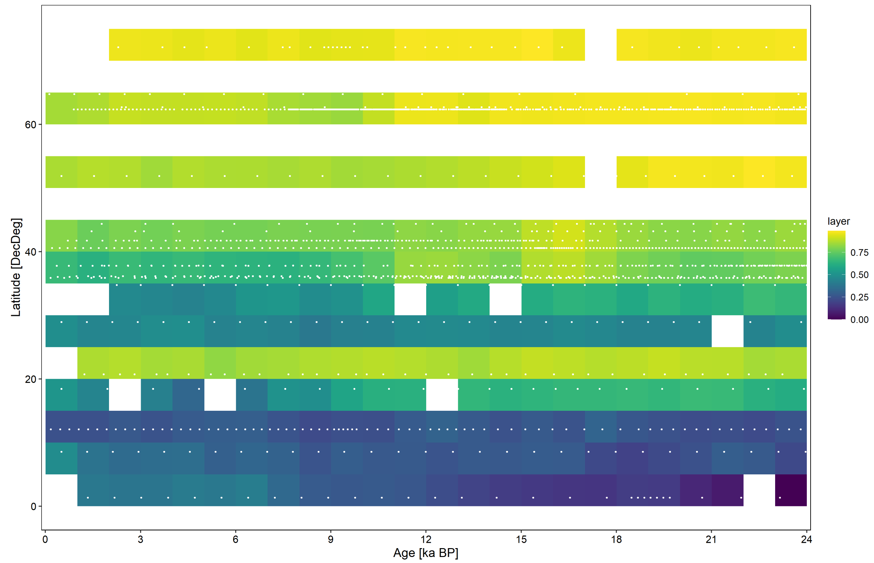
Hovmoller plot: gridded Bray-Curtis distance to oldest tropical sample
Tropical reference core: V25-59
White dots indicate individual samples
Holocene samples of mid latitude records are closer to oldest tropical sample than older samples
→ Indication of tropical species moving into mid latitudes during the last deglaciation?
Note: high values at 20° N are caused by core 108-658C which is situated in the upwelling area that is centred around Cape Blanc

